Slide 1
S J C INSTITUTE OF TECHNOLOGY
DEPARTMENT OF COMPUTER SCIENCE AND ENGINEERING
Internship on
“LUNG CANCER PREDICTION”
PRESENTED BY
NAGASHREE CR 1SJ20CS092
Guide Name COORDINATOR Head of Department
Prof. Ashok K N Prof. Swetha H Dr. Manjunatha Kumar B H
Assistant Professor Assistant Professor Professor And Hod
Dept. Of CSE,SJCIT Dept. Of CSE,SJCIT Dept. Of CSE,SJCIT
UNDER THE GUIDANCE OF

Slide 2
CONTENTS
Company profile
Abstract
Introduction
Existing system and its disadvantages
Proposed system and its advantages
System requirements and specification
Modules
System architecture
Screen shots
Conclusion
References

Slide 3

COMPANY PROFILE
Inflow Technologies addresses the growing needs of organizations.
1.The team at Inflow Technologies are well- versed with latest and the most powerful technologies.
2.Founded in 2005, Inflow Technologies is a niche player in theIT Distribution Services.
.

Slide 4
ABSTRACT
The recent development of imaging and sequencing technologies enables systematic advances in the clinical study of lung cancer.
Machine learning-based approaches play a critical role in integrating and analyzing these large and complex datasets, which have extensively characterized lung cancer through the use of different perspectives from these accrued data.

Slide 5
INTRODUCTION
Lung cancer is one of the most frequently diagnosed cancers and the leading cause of cancer deaths worldwide.
ML is a subgroup of artificial intelligence (AI) that focuses on making predictions by identifying patterns in data using mathematical algorithms.
It has served as an assisting tool in cancer phenotyping and therapy for decades and has been widely implemented in advanced approaches.

Slide 6
EXISTING SYSTEMS AND ITS DISADVANTAGES
The use of artificially intelligent systems in any industry, including healthcare, has its limitations and obstacles.
Here, we address various limitations of AI and machine learning with an emphasis on those that are particularly relevant to healthcare:1.Data privacy 2.Fragmented data 3.Knowledge Graphs (KG) 4.Scale and 5. Complicated data.

Slide 7
PROPOSED SYSTEM A ND ITS ADVANTAGES
Algorithms based on artificial intelligence have been shown to be capable of analyzing unstructured data and correctly estimating the likelihood of patients getting different illnesses, including cancer.
These algorithms can benefit those people who are at high risk of developing cancer or High-risk persons who are not covered in the existing screening criteria.

Slide 8
SYSTEM REQUIREMENTS AND SPECIFICATONS
Requirement analysis determines the requirements of a new system. This project analyses on product and resource requirement, which is required for this successful system.
Hardware requirements : i5 intel 8th Gen Processor ,12 GB RAM , 1 TB Hard Disk,4 GB Nvidia GPU ,Monitor , Web camera
Software requirements :Windows 10 , Web Browser , Python Package Manager ,IDE ,Linux

Slide 9
MODULES
Pre-processing layer
Segmentation layer
Feature extraction layer
Classification layer
These are the four layer of modules

Slide 10
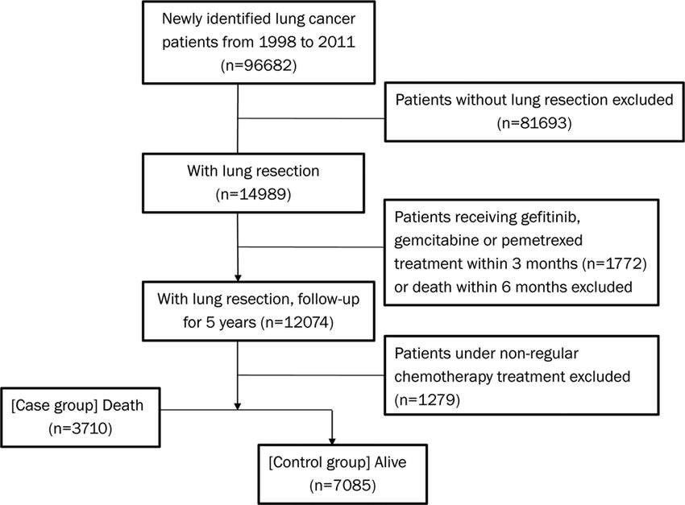
SYSTEM ARCHITECTURE

Slide 11
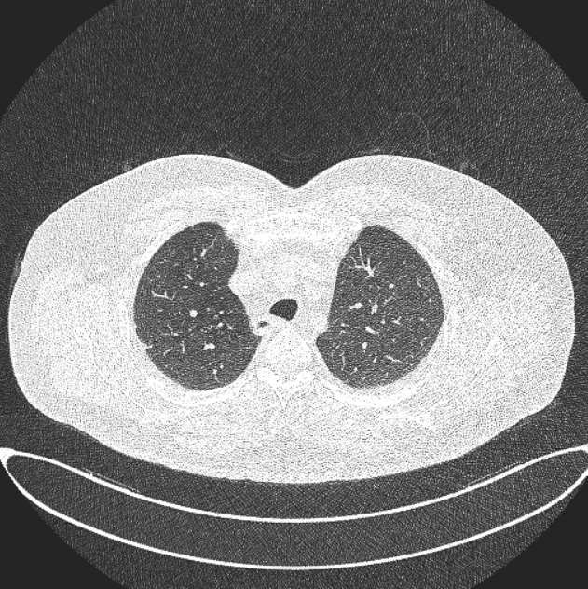
SCREEN SHOTS
THE IMAGE –BEGNINE CASE

Slide 12
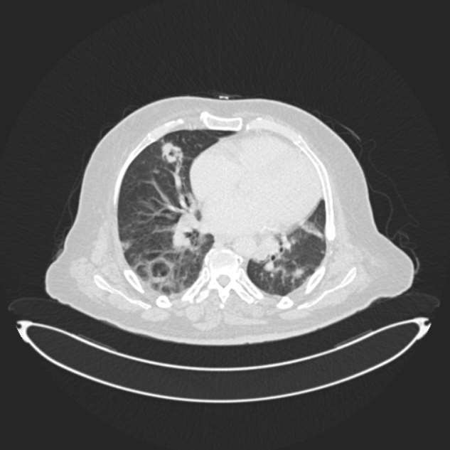
.
The image- malignant case

Slide 13
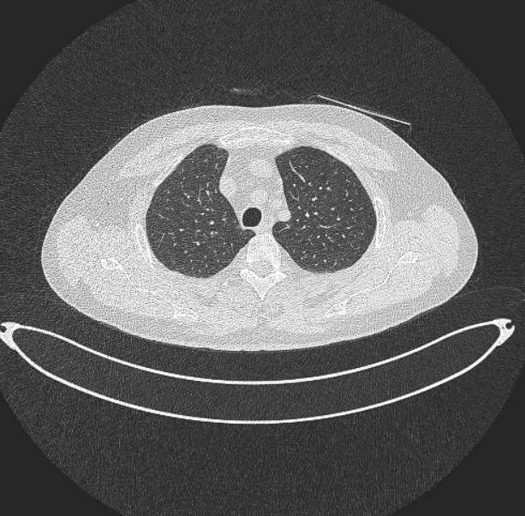
.
The image-Normal case

Slide 14
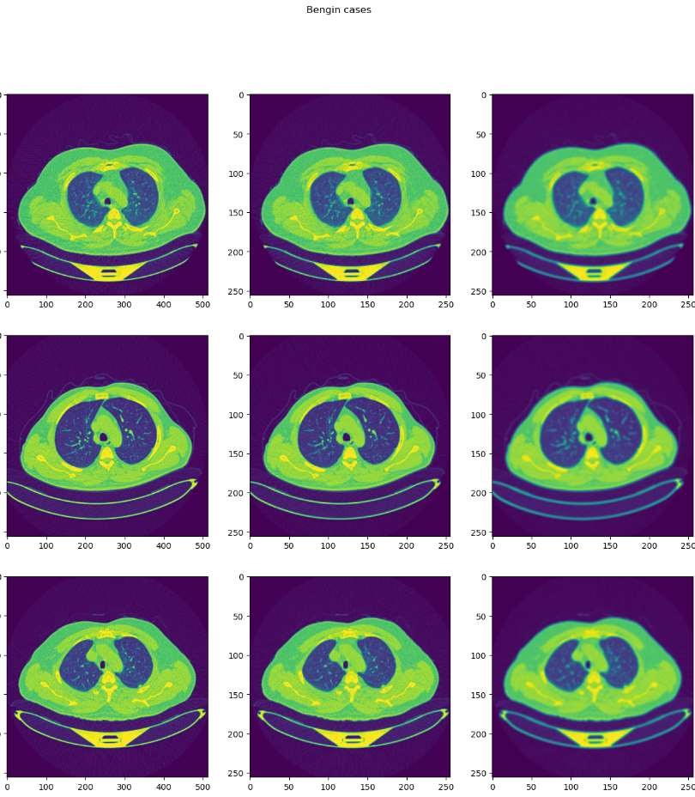

Slide 15
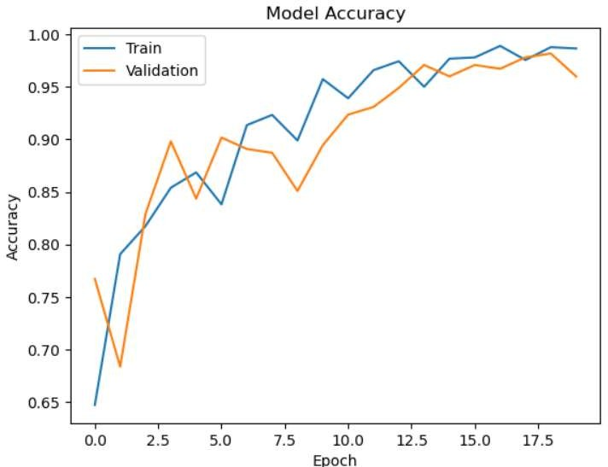

Slide 16
CONCLUSION
AI-ML has flourished in this era due to the technical advances of the time. Previously, these novel innovations were exclusively used for non-medical purposes, but they are now starting to be implemented for the improvement of healthcare around the world. AI and ML have a substantial impact on healthcare and will continue to reshape this field.

Slide 17
REFERENCES
G. S. Ramachandra, S. Savitha, and R. N. Deepthi, "A Comparative Study of Machine Learning Techniques for lung cancer Prediction“
International Journal of Engineering and Advanced Technology, vol. 8, no. 4, pp. 381-385, 2019.2.S.
Tahir and S. H. Shah, "A Machine Learning Approach to Predicting of Lung Cancer," .
International Journal of Advanced Computer Science and Applications, vol. 10, no. 8, pp. 371-377, 2019.3.
J. Li, Y. Liu, and X. Li, "Research on House Price Prediction Model Based on Machine Learning," in 2019.

